Slide 1

AI Based Resume Ranking System for Efficient Candidate Shortlisting
Submitted in the partial fulfillment for the award of the degree of
BACHELOR OF ENGINEERING
IN
NAME_OF_SPECIALIZED_BRANCH
Submitted by:
Under the Supervision of:
Prof. Ranjan Walia
Lakshay Bhardwaj | 22BAI70057
Yudhistir Kumar | 22BAI70012
Mohit Sahni | 22BAI70006
Rounak Singh | 22BAI70119
Department of AIT-CSE
DISCOVER . LEARN . EMPOWER

Slide 2
Outline
• Introduction to Project
• Problem Formulation
• Objectives of the Work
• Methodology Used
• Results and Outputs
• Conclusion
• Future Scope
• References

Slide 3
Introduction to Project
Recruitment is a vital process but manual resume screening is time-consuming, error-prone, and biased.
This project proposes an AI-based Resume Ranking System using NLP and Machine Learning.
System extracts skills, education, and work experience from resumes.

Slide 4
Introduction to Project
Resumes are matched against job descriptions to calculate a relevance score.
Helps recruiters shortlist candidates efficiently, objectively, and fairly.
Demonstrates practical application of AI & ML in HR automation.

Slide 5
Problem Formulation
Traditional recruitment involves manual shortlisting which is inefficient for large-scale hiring.
Recruiters face challenges: large applicant pool, bias and inconsistency, time and cost inefficiency.

Slide 6
Problem Formulation
Need: An automated, intelligent system that can analyze resumes, understand job requirements,
and generate ranked lists of suitable candidates.

Slide 7
Objectives of the Work
• Develop an AI-based model that ranks resumes against job descriptions.
• Use NLP techniques for extracting and processing textual features.
• Compute semantic similarity between resumes and job requirements.
• Generate an automated, unbiased, and efficient shortlisting process.

Slide 8
Methodology Used
Step 1: Data Collection – Resumes and Job Descriptions dataset
Step 2: Preprocessing – Tokenization, stopword removal, stemming/lemmatization

Slide 9
Methodology Used
Step 3: Feature Extraction – TF-IDF, Word2Vec, Transformer embeddings (BERT)
Step 4: Model Training – Logistic Regression, SVM, Ranking models

Slide 10
Methodology Used
Step 5: Resume Ranking – Calculate relevance score and sort resumes
Step 6: Evaluation – Precision, Recall, Accuracy, F1-score
Include flowchart/DFD in this section.
Data Collection
Preprocessing
Feature Extraction
Model Training
Resume Ranking
Evaluation

Slide 11
Results and Outputs
Resume Parsing Output: Extracted skills, education, and experience.

Slide 12
Results and Outputs
Ranking Table: Candidates ranked based on job description relevance.
Candidate | Relevance Score | Rank
Alice | 0.92 | 1
Bob | 0.87 | 2
Charlie | 0.80 | 3
David | 0.75 | 4
Eve | 0.70 | 5

Slide 13
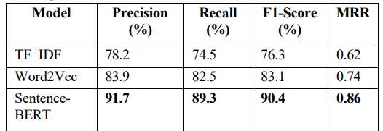
Results and Outputs
Performance Metrics: Accuracy, Precision, Recall, F1-score.

Slide 14
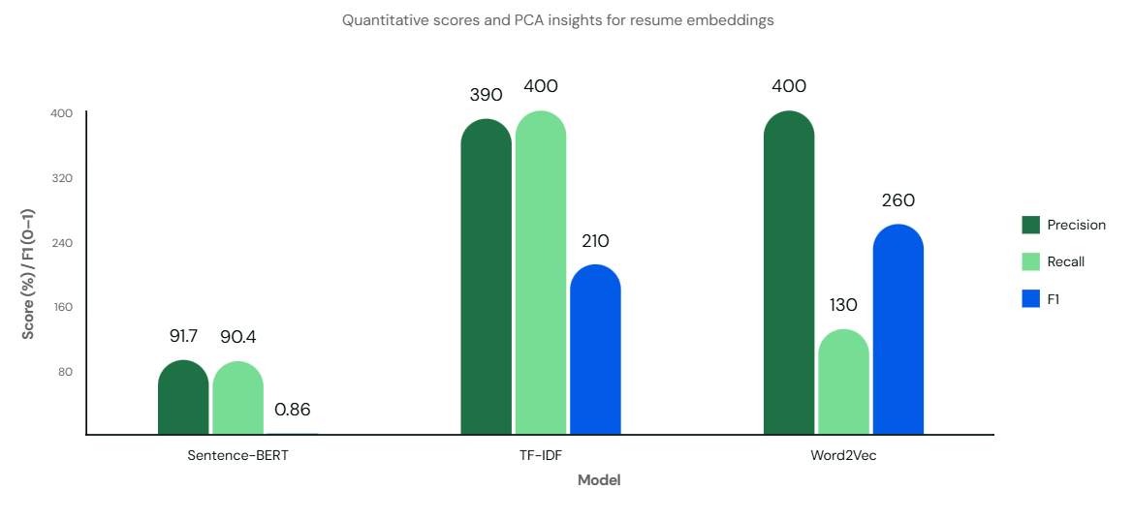
Results and Outputs
Graphs/Visualizations: Include bar chart/confusion matrix placeholders.

Slide 15
Conclusion
• Developed an AI-based Resume Ranking System for efficient candidate shortlisting.
• Reduces time, effort, and human bias in recruitment.
• Improves accuracy and fairness of candidate evaluation.
• Demonstrates practical application of NLP and ML in HR automation.

Slide 16
Future Scope
• Integration with ATS (Applicant Tracking Systems) for industry deployment.
• Use of advanced transformer models (BERT, RoBERTa, GPT) for better semantic matching.
• Addition of multi-language resume processing.
• Support for real-time resume screening in job portals.

Slide 17
References
1. Mikolov, T., et al., “Efficient Estimation of Word Representations in Vector Space,” arXiv, 2013.
2. Devlin, J., et al., “BERT: Pre-training of Deep Bidirectional Transformers for Language Understanding,” NAACL, 2019.
3. Jurafsky, D., Martin, J. H., Speech and Language Processing, Pearson, 2021.

Slide 18
References
4. Scikit-learn documentation: https://scikit-learn.org
5. HuggingFace Transformers: https://huggingface.co/transformers
6. Python NLP Libraries Documentation (NLTK, spaCy)

